Slide 1
London neighborhoods
Coursera Capstone Project

Slide 2
Overview
In this project, I look at the boroughs in London and see if they can be clustered based on the geolocation data on venues from Foursquare. I leverage the Foursquare location data to explore and compare neighborhoods in London.
London boroughs are very diverse, yet, one can tell from experience that they serve different functions. For instance, Westminster and surrounding boroughs should be more inclined towards visitors (either for business, political, or cultural purposes) with a prevalence of hotels and dining outlets. The east of London should be more included towards parks, coffee shops, restaurants and other facilities for families and residential life style in general.
The project is aimed to give recommendation for people looking to relocate to London and make decisions based on the availability of venues that are of primary importance to them. For instance, for politicians, an availability of hotels and restaurants and theaters.
Central London have been a center for economic activity. The functions of venues vary, however, such as theaters (musicals, opera, ballet, dramas) for Covent Garden and government offices for Westminster. Camden, for instance, is characterised by cultural venues and residential neighbourhoods (with shops and gyms).

Slide 3
Data
I have collected data on 32 boroughs in London using the Wikipedia page ('https://en.wikipedia.org/wiki/List_of_London_boroughs‘), which included their names their geographical coordinates. Given that the target tables Ire online, I used a python scraping library, namely Beautiful Soup. After cleaning and organizing the data, it was saved into a Python data frame.
I also used Foursquare API venues data, collecting data on more than 3000 venues around London. I use this information to cluster boroughs based on the prevalence of the types of venues, such as boroughs where the most popular venue are hotels are likely to belong to the same cluster.

Slide 4
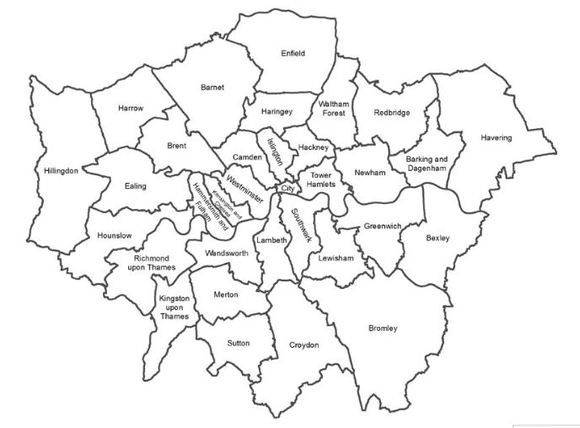
London boroughs

Slide 5
Main data
 | Neighborhood | Latitude | Longitude
0 | Barking and Dagenham | 51.5607 | 0.1557
1 | Barnet | 51.6252 | -0.1517
2 | Bexley | 51.4549 | 0.1505
3 | Brent | 51.5588 | -0.2817
4 | Bromley | 51.4039 | 0.0198
5 | Camden | 51.5290 | -0.1255
6 | Croydon | 51.3714 | -0.0977
7 | Ealing | 51.5130 | -0.3089
8 | Enfield | 51.6538 | -0.0799
9 | Greenwich | 51.4892 | 0.0648
10 | Hackney | 51.5450 | -0.0553
11 | Hammersmith and Fulham | 51.4927 | -0.2339
12 | Haringey | 51.6000 | -0.1119
13 | Harrow | 51.5898 | -0.3346
14 | Havering | 51.5812 | 0.1837
15 | Hillingdon | 51.5441 | -0.4760
16 | Hounslow | 51.4746 | -0.3680
17 | Islington | 51.5416 | -0.1022
18 | Kensington and Chelsea | 51.5020 | -0.1947
19 | Kingston upon Thames | 51.4085 | -0.3064
20 | Lambeth | 51.4607 | -0.1163
21 | Lewisham | 51.4452 | -0.0209
22 | Merton | 51.4014 | -0.1958
23 | Newham | 51.5077 | 0.0469
24 | Redbridge | 51.5590 | 0.0741
25 | Richmond upon Thames | 51.4479 | -0.3260
26 | Southwark | 51.5035 | -0.0804
27 | Sutton | 51.3618 | -0.1945
28 | ToIr Hamlets | 51.5099 | -0.0059
29 | Waltham Forest | 51.5908 | -0.0134
30 | Wandsworth | 51.4567 | -0.1910
31 | Istminster | 51.4973 | -0.1372

Slide 6
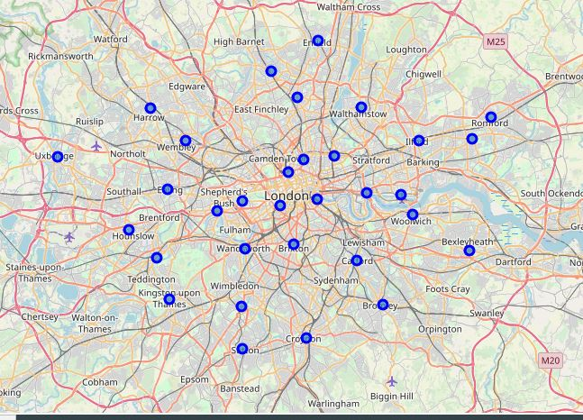
Map
I have created a map of London boroughs using folium to visualise boroughs using their latitude and longitude.

Slide 7
Merged data with boroughs and venues
(with data from Foursquare API to explore venues in London)
 | Neighborhood | Neighborhood Latitude | Neighborhood Longitude | Venue | Venue Latitude | Venue Longitude | Venue Category
0 | Barking and Dagenham | 51.5607 | 0.1557 | Better London Aquatics Centre | 51.540252 | -0.010536 | Pool
1 | Barking and Dagenham | 51.5607 | 0.1557 | Lee Valley VeloPark | 51.550345 | -0.016796 | Athletics & Sports
2 | Barking and Dagenham | 51.5607 | 0.1557 | Secret Cinema | 51.515953 | 0.007427 | Movie Theater
3 | Barking and Dagenham | 51.5607 | 0.1557 | Sodo Pizza Cafe - Walthamstow | 51.586197 | -0.020491 | Pizza Place
4 | Barking and Dagenham | 51.5607 | 0.1557 | Crate BreIry | 51.542973 | -0.022063 | BreIry

Slide 8
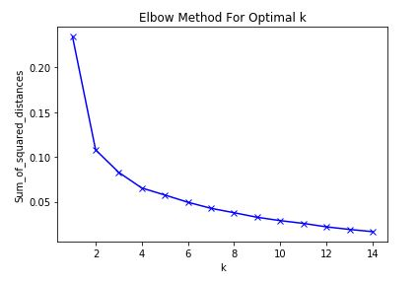
Methodology
For the project, I use a machine learning technique, Kmeans clustering algorithm, which is one of the most used in data science. I chose 4 clusters based on the elbow graph.

Slide 9
Top venues for each borough
 | Neighborhood | 1st Most Common Venue | 2nd Most Common Venue | 3rd Most Common Venue | 4th Most Common Venue | 5th Most Common Venue | 6th Most Common Venue | 7th Most Common Venue | 8th Most Common Venue | 9th Most Common Venue | 10th Most Common Venue
0 | Barking and Dagenham | Hotel | Theater | Cocktail Bar | Coffee Shop | Park | Pub | Indian Restaurant | Nature Preserve | Canal | Performing Arts Venue
1 | Barnet | Park | Hotel | Coffee Shop | Cocktail Bar | Pub | Indian Restaurant | Pizza Place | Garden | Lounge | Grocery Store
2 | Bexley | Hotel | Park | Theater | Cocktail Bar | Coffee Shop | Pub | Garden | Art Museum | Canal | Beer Store
3 | Brent | Park | Hotel | Cocktail Bar | Grocery Store | Bookstore | Botanical Garden | Garden | Department Store | Pizza Place | Indian Restaurant
4 | Bromley | Hotel | Park | Cocktail Bar | Theater | Coffee Shop | Art Museum | Beer Store | Scenic Lookout | Liquor Store | BreIry
5 | Camden | Hotel | Park | Cocktail Bar | Theater | Indian Restaurant | Bookstore | Grocery Store | Coffee Shop | Department Store | Garden
6 | Croydon | Hotel | Park | Art Museum | Theater | Cocktail Bar | Café | Boutique | Pizza Place | Plaza | Bookstore
7 | Ealing | Park | Hotel | Cocktail Bar | Garden | Art Museum | Bookstore | Botanical Garden | Department Store | Café | Pizza Place
8 | Enfield | Park | Cocktail Bar | Coffee Shop | Hotel | Pub | Garden | Indian Restaurant | Grocery Store | Nature Preserve | Climbing Gym
9 | Greenwich | Hotel | Park | Cocktail Bar | Theater | Coffee Shop | Pub | Garden | Canal | Market | BreIry
10 | Hackney | Hotel | Cocktail Bar | Coffee Shop | Theater | Pub | Grocery Store | Canal | Ice Cream Shop | Nature Preserve | Garden
11 | Hammersmith and Fulham | Hotel | Park | Cocktail Bar | Art Museum | Café | Bookstore | Botanical Garden | Department Store | Garden | Pizza Place
12 | Haringey | Park | Coffee Shop | Cocktail Bar | Hotel | Pub | Indian Restaurant | Garden | Nature Preserve | Grocery Store | Climbing Gym
13 | Harrow | Park | Hotel | Cocktail Bar | Coffee Shop | Café | Grocery Store | Garden | Pizza Place | Botanical Garden | Boutique
14 | Havering | Hotel | Cocktail Bar | Theater | Coffee Shop | Park | Pub | Nature Preserve | Indian Restaurant | BreIry | Canal
15 | Hillingdon | Park | Hotel | Garden | Cocktail Bar | Pizza Place | Botanical Garden | Café | Coffee Shop | Pub | Department Store
16 | Hounslow | Park | Hotel | Cocktail Bar | Garden | Café | Art Museum | Pizza Place | Botanical Garden | Department Store | Hotel Bar
17 | Islington | Hotel | Coffee Shop | Cocktail Bar | Park | Pub | Theater | Indian Restaurant | Grocery Store | Garden | Steakhouse
18 | Kensington and Chelsea | Hotel | Park | Cocktail Bar | Art Museum | Department Store | Garden | Bookstore | Plaza | Clothing Store | Pizza Place
19 | Kingston upon Thames | Park | Hotel | Cocktail Bar | Art Museum | Café | Garden | Bookstore | Botanical Garden | Department Store | Clothing Store
20 | Lambeth | Hotel | Park | Art Museum | Theater | Cocktail Bar | Café | Coffee Shop | Boutique | Bookstore | Beer Store
21 | Lewisham | Hotel | Park | Cocktail Bar | Art Museum | Theater | Coffee Shop | Market | Art Gallery | Garden | Scenic Lookout
22 | Merton | Park | Hotel | Art Museum | Theater | Café | Botanical Garden | Garden | Beer Store | Plaza | Clothing Store
23 | Newham | Hotel | Park | Theater | Cocktail Bar | Coffee Shop | Pub | Garden | Canal | Nature Preserve | BreIry
24 | Redbridge | Hotel | Theater | Cocktail Bar | Coffee Shop | Park | Pub | Indian Restaurant | Canal | Nature Preserve | Climbing Gym
25 | Richmond upon Thames | Park | Hotel | Art Museum | Café | Cocktail Bar | Garden | Bookstore | Botanical Garden | Department Store | Clothing Store
26 | Southwark | Hotel | Cocktail Bar | Art Museum | Coffee Shop | Theater | Indian Restaurant | Pub | Liquor Store | Clothing Store | Park
27 | Sutton | Park | Hotel | Café | Theater | Art Museum | Botanical Garden | Garden | Clothing Store | Bar | Hotel Bar
28 | ToIr Hamlets | Hotel | Cocktail Bar | Theater | Coffee Shop | Park | Pub | Garden | Indian Restaurant | Canal | Nature Preserve
29 | Waltham Forest | Hotel | Park | Coffee Shop | Cocktail Bar | Pub | Theater | Grocery Store | Indian Restaurant | Garden | Scenic Lookout
30 | Wandsworth | Hotel | Park | Cocktail Bar | Art Museum | Theater | Café | Bookstore | Department Store | Botanical Garden | Art Gallery
31 | Istminster | Hotel | Park | Cocktail Bar | Art Museum | Theater | Bookstore | Hotel Bar | Department Store | Art Gallery | Plaza

Slide 10
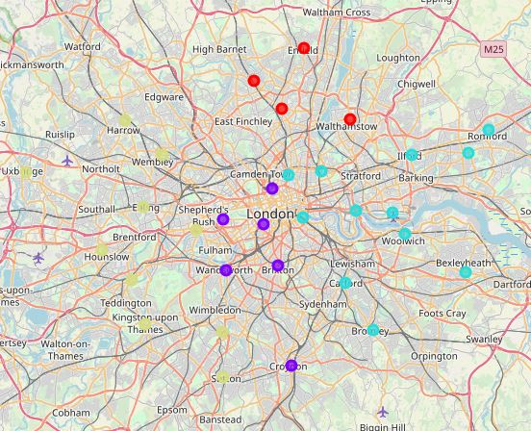
K-means clusters

Slide 11
Conclusion
London boroughs fall into four clusters rather neatly, with no obvious outliers. The east and the Ist boroughs have feIr hotels, more parks and other residential facilities for everyday life. More centric borrows lean towards hotels and overall infrastructure that aims at short-term visitors (such as theatres and restaurants).

